Slide 1
Goals & Performance Review Process Part I Employee Reviews

Slide 2
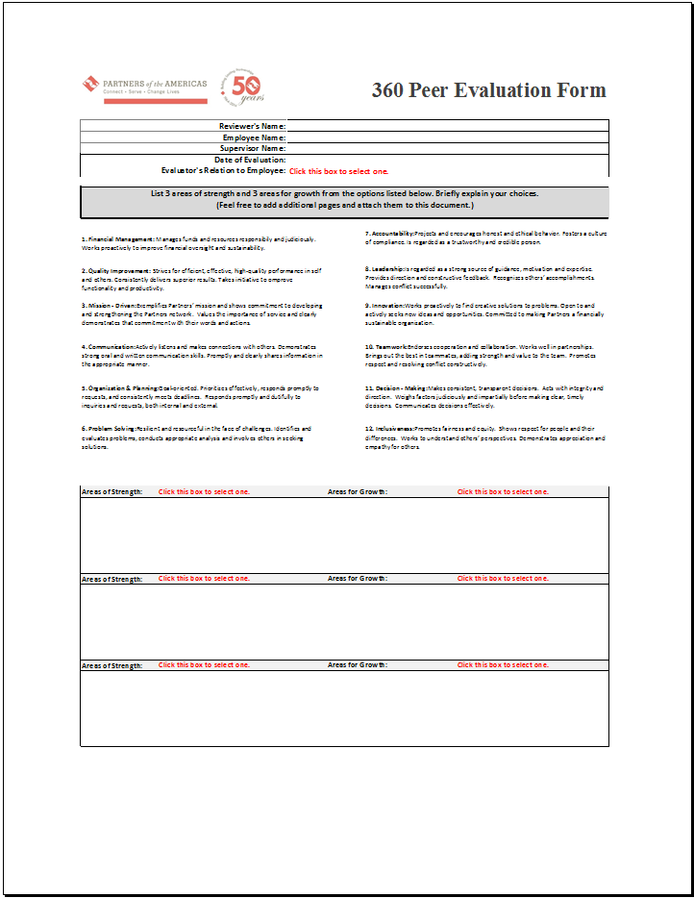
Beginning October 28th Supervisors will request two or three (2 min.-3 max.) confidential 360º Peer Evaluations from colleagues of each employee.
All 360º Peer Evaluations are due by close of business on November 13th.

Slide 3
Supervisors will email each of their employees a copy of the 2014 Employee Goals & Performance Evaluation Form and the 2015 Employee Goals & Performance Expectations Form.
In the email, Supervisors will ask the employee to fill in Section A and Section B with the ratings that they believe they have earned for that specific goal. Employees must also complete the 2015 Employee Goals & Performance Expectations Form at this time.
Once the employee completes the 2014 Employee Goals & Performance Evaluation Form and the 2015 Employee Goals & Performance Expectations Form in its entirety, they will email the completed forms to their supervisor.

Slide 4
Once the Supervisor receives the completed 2014 Employee Goals & Performance Evaluation Form and the 2015 Employee Goals & Performance Expectations Form, they will promptly set a date and time to meet with the employee.
The objectives that should be achieved during the one on one meeting are as follows:
For the supervisor and employee to discuss the ratings and comments on the 2014 Employee Goals & Performance Evaluation Form.
Review the 2015 Goals & Performance Expectations Form.
Supervisor and employee to agree on the final ratings that will be submitted to F&A.

Slide 5


After the one on one meeting has taken place. The supervisor will finalize the 2014 Employee Goals & Performance Evaluation Form and the 2015 Employee Goals & Performance Expectations Form by entering all final data. The supervisor must also complete the Salary Increase Form if applicable.
The forms must then be printed and signed by both the employee and supervisor. Supervisors will then turn in all final documents to F&A.
Please only submit hard copies, not soft copies of employee documents.
This will conclude the employee review (Part I) and begin the supervisor’s evaluation process (Part II).

Slide 6
2014 Goals & Performance Review Process Part II Program/Unit Manager Reviews

Slide 7
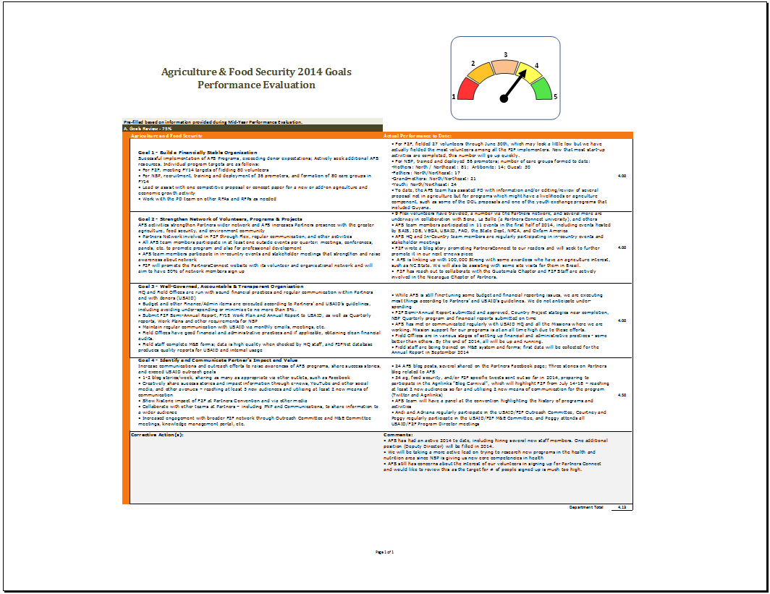
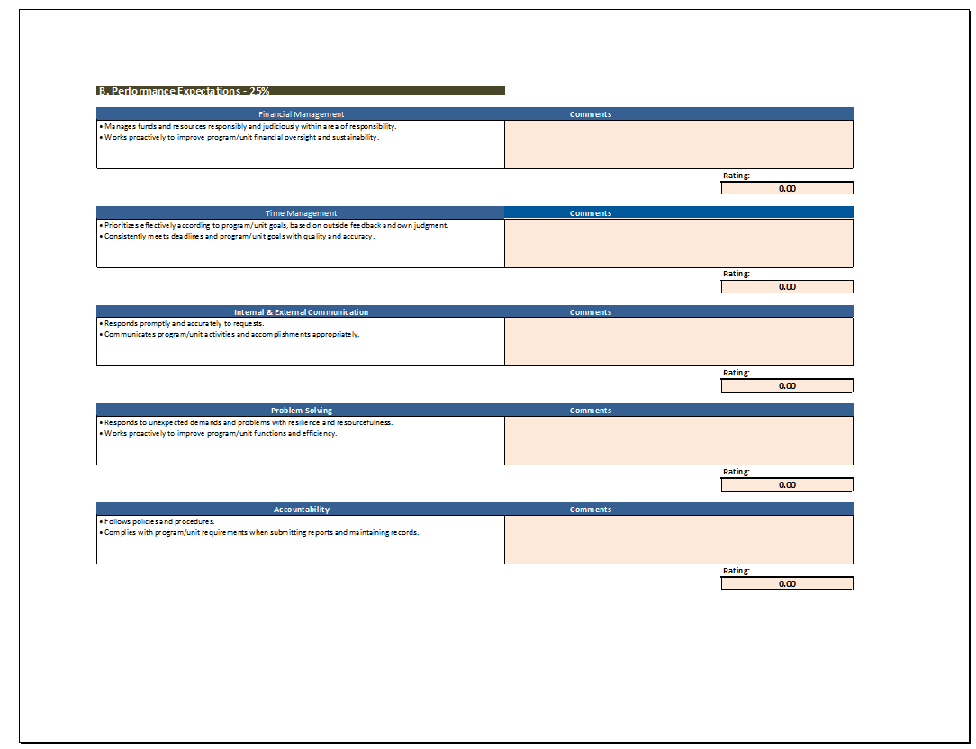
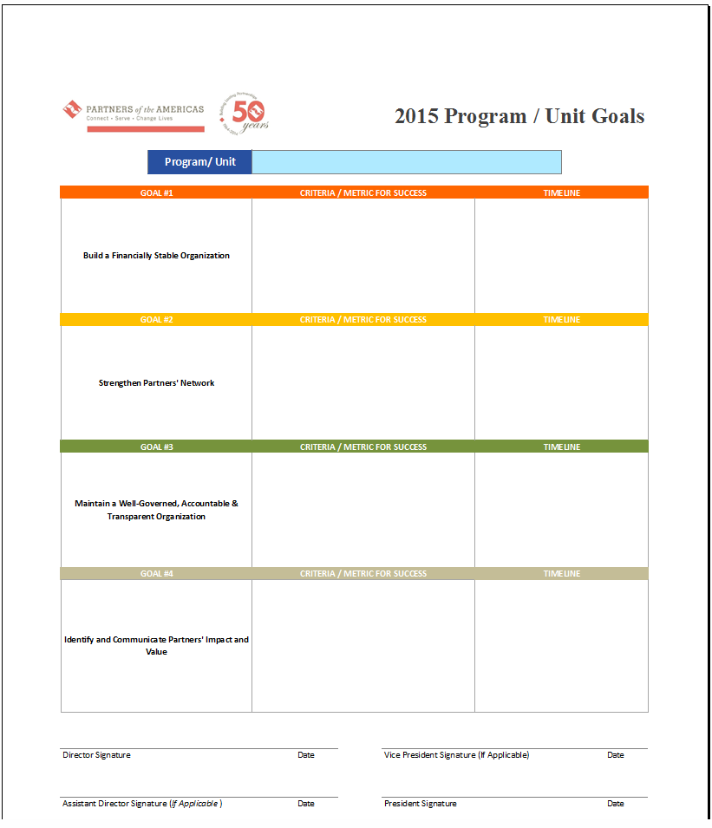
Program/Unit Managers will be evaluated based on performance in achieving their 2014 Program/Unit goals.
F&A will email each Program/Unit manager their respective 2014 Program/Unit Goals & Performance Evaluation Workbook (See Example Below) and a blank 2015 Program/Unit Goals Form.
The workbook is pre-filled based on data given and presented during midyear reviews.

Slide 8
Program/Unit Managers will update Section A. with the information as needed, including the ratings. They will also complete Section B. by entering the ratings they believe they have earned.
Once this has been completed, Program/Unit Managers will email their 2014 Program/Unit Goals & Performance Evaluation Workbook and 2015 Program/Unit Goals Form to Senior Management and schedule a one on one meeting to review their ratings.
The objectives that should be achieved during the one on one meeting are as follows:
For the Program/Unit Manager and Senior Management and to discuss the ratings and comments on the 2014 Program/Unit Goals & Performance Evaluation Form.
Review the 2015 Program/Unit Goals Form.
Program/Unit Manager and Senior Management to agree on the final ratings and goals that will be submitted to F&A.

Slide 9
After the one on one meeting has taken place, the Program/Unit Manager will finalize the 2014 Program/Unit Goals & Performance Evaluation Workbook and the 2015 Program/Unit Goals Form by entering all final data.
In the interim Senior Management will complete the Salary Increase Form if applicable for the Program/Unit Manager.
The forms must then be printed and signed by both Program/Unit Managers and Senior Management. Once the printed forms have been signed, the Program/Unit Manager will submit hard copies and soft copies to F&A.
This will conclude the Program/Unit Manager Reviews (Part II).

Slide 10

Questions?

